Slide 1

Azure
Project
Write your Name
Lynn Haydar 202212989
Professor: Dr. Hussein Lakkis
Deploy Cloud App
Efficiently

Slide 2
Project
Setup
01
Go to DevOps and create a new project

Slide 3
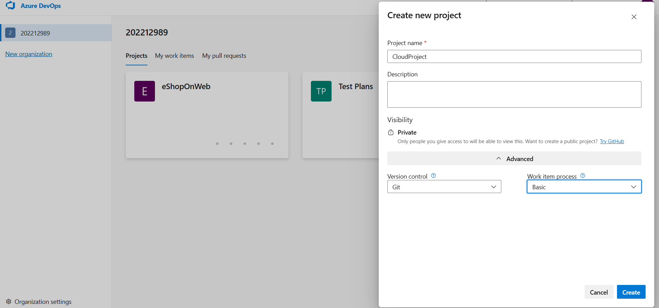
Creating a new Project

Slide 4
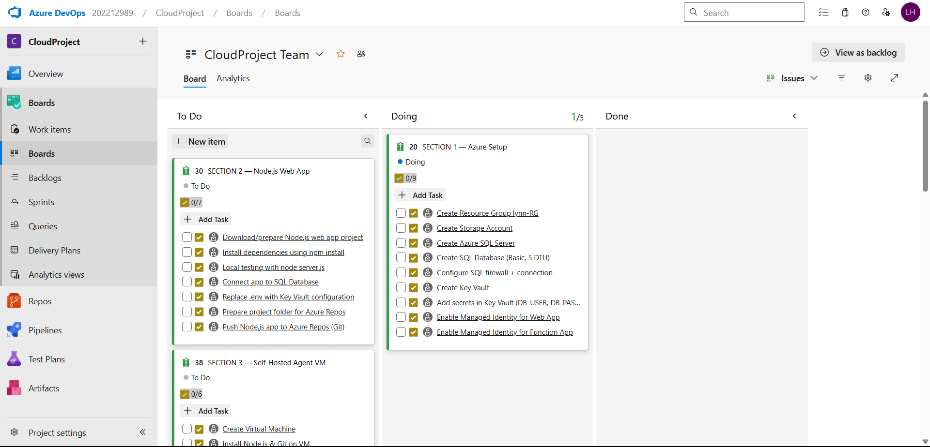
Add tasks in Azure Boards

Slide 5
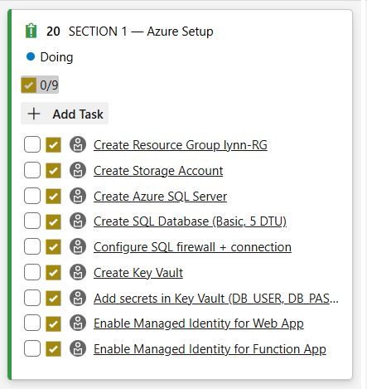
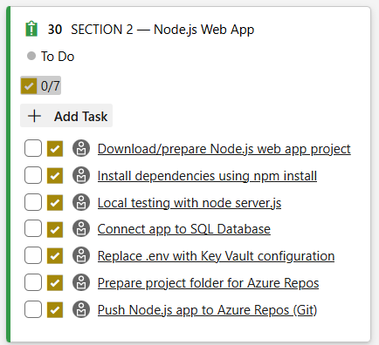
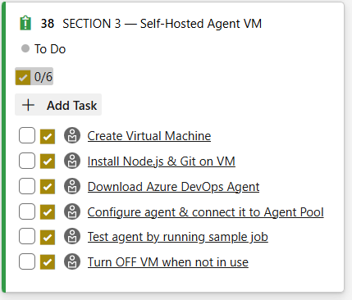
Boards

Slide 6
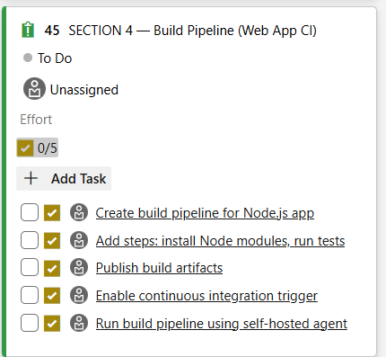
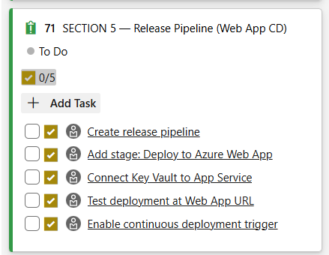
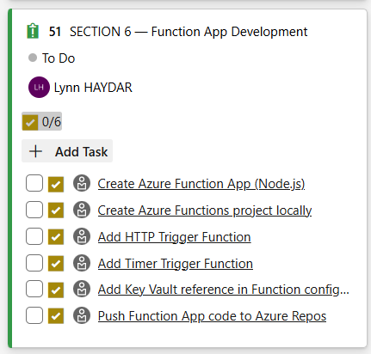
Boards

Slide 7
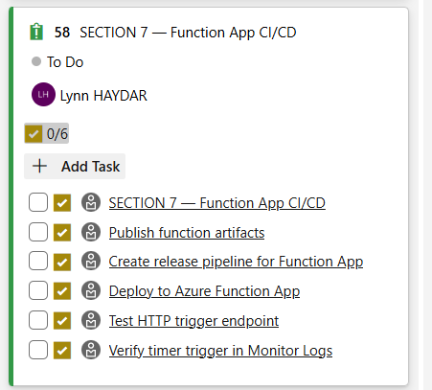
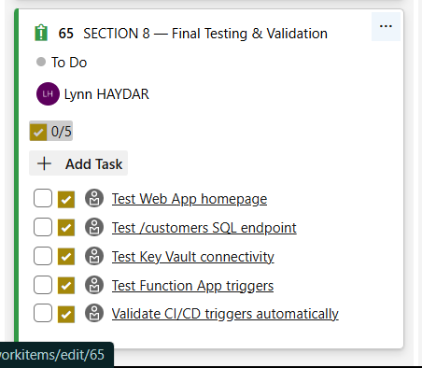
Boards

Slide 8

Create Azure Resources
02
Log in to the Azure Portal

Slide 9
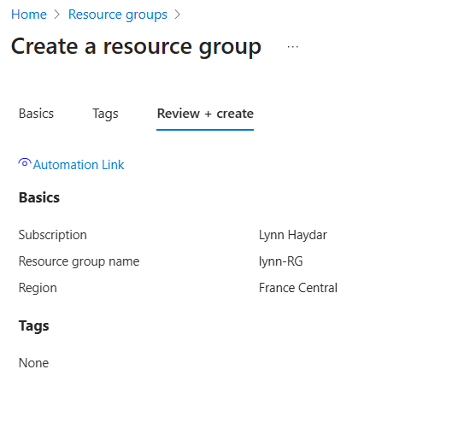
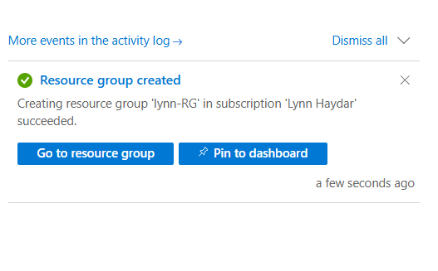
Create Resource Group

Slide 10
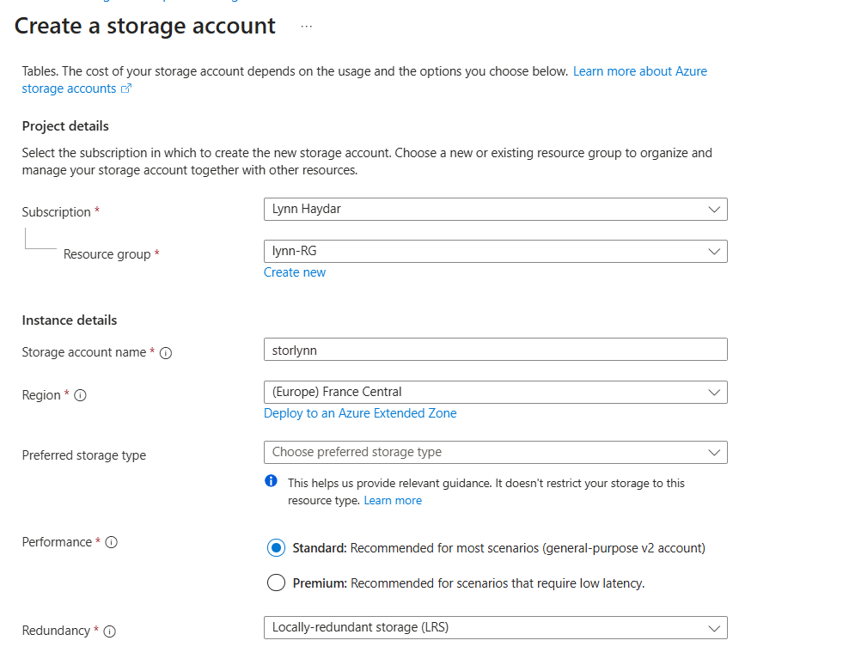
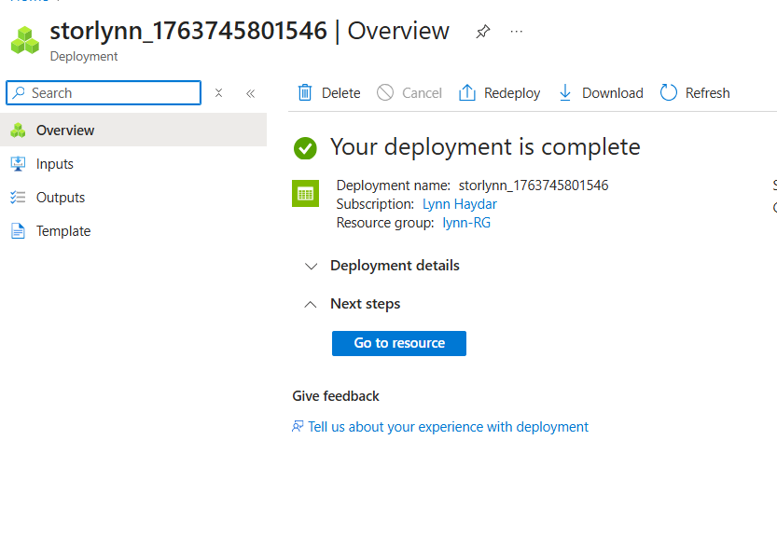
Create Storage Account

Slide 11
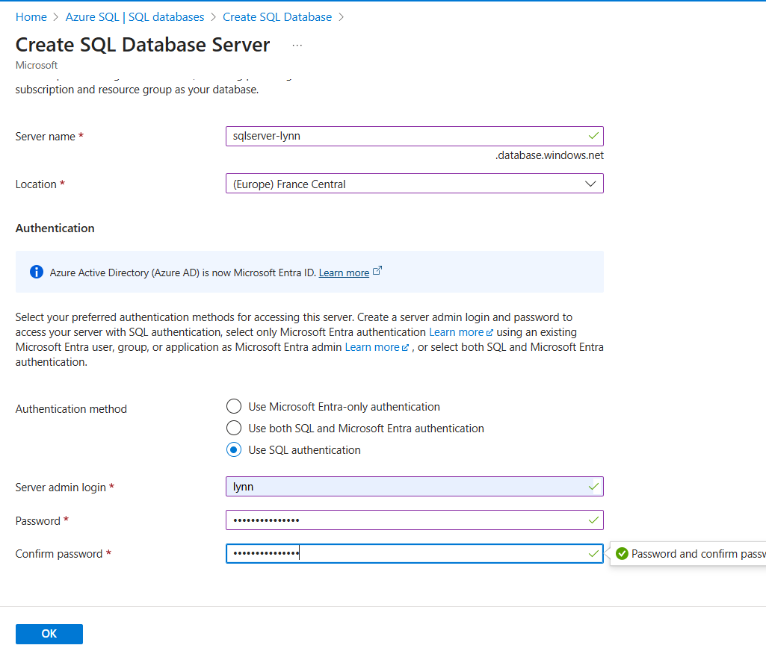
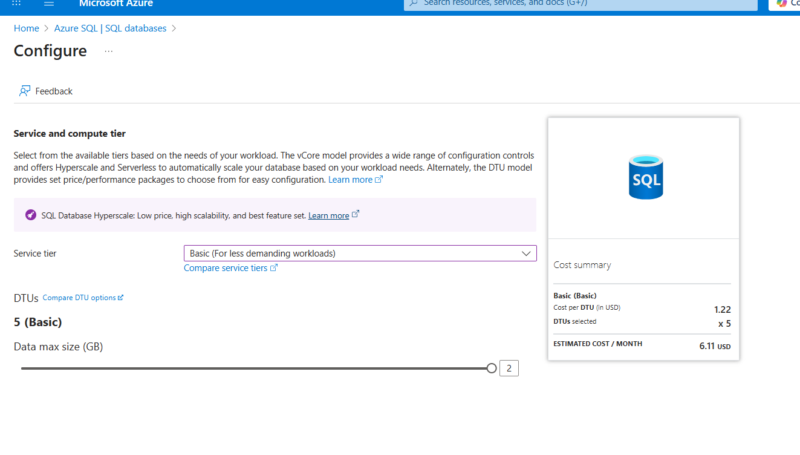
Create Azure SQL Server + DB

Slide 12
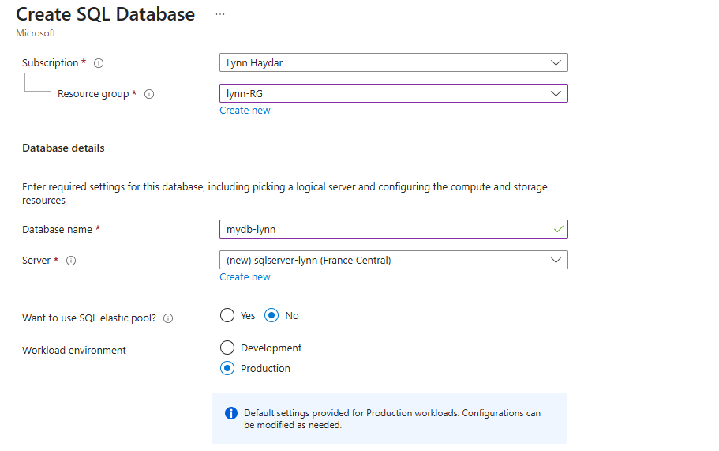
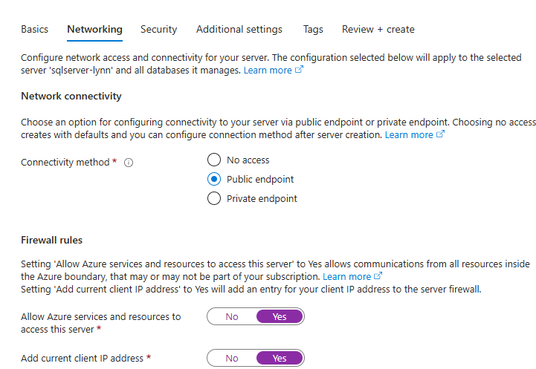
Create Azure SQL Server + DB

Slide 13
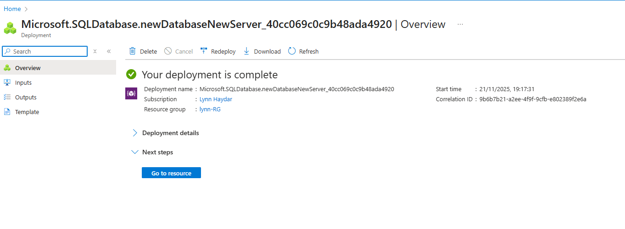
Create Azure SQL Server + DB

Slide 14
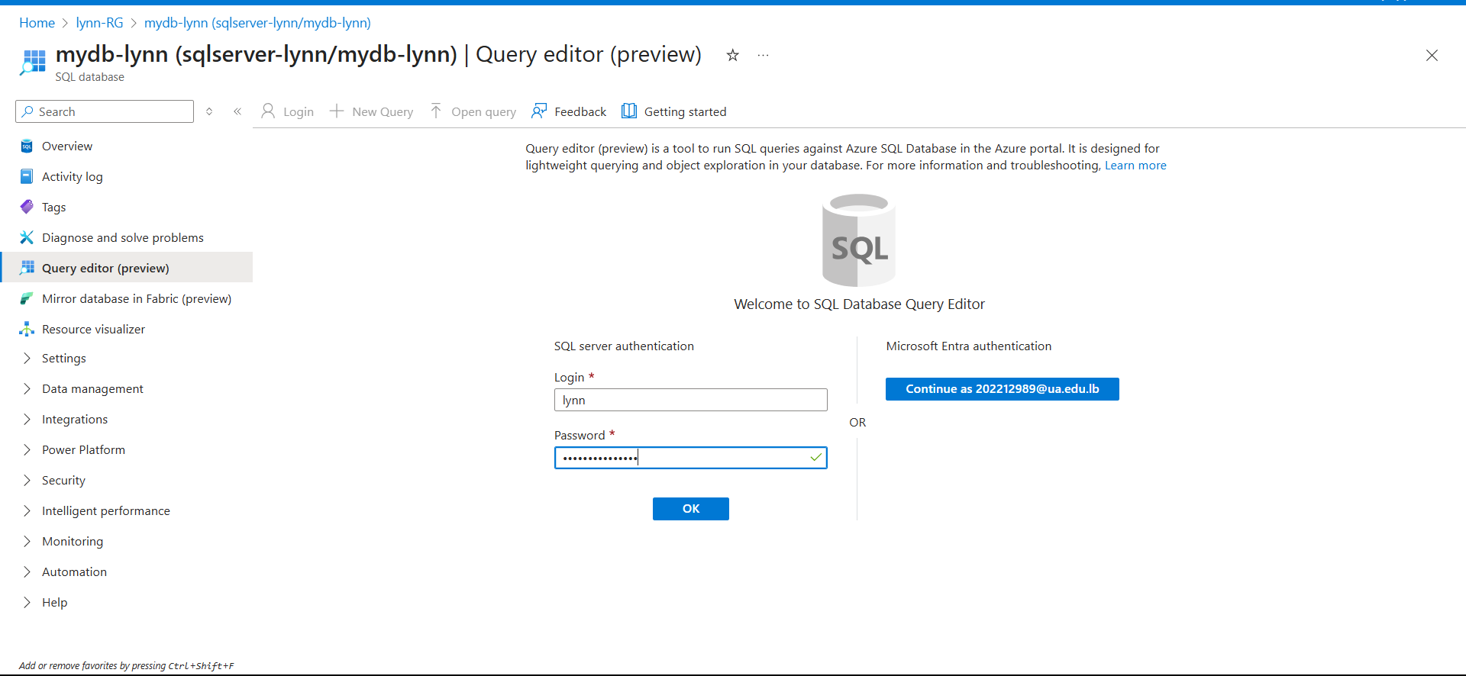
Create the Messages Table

Slide 15
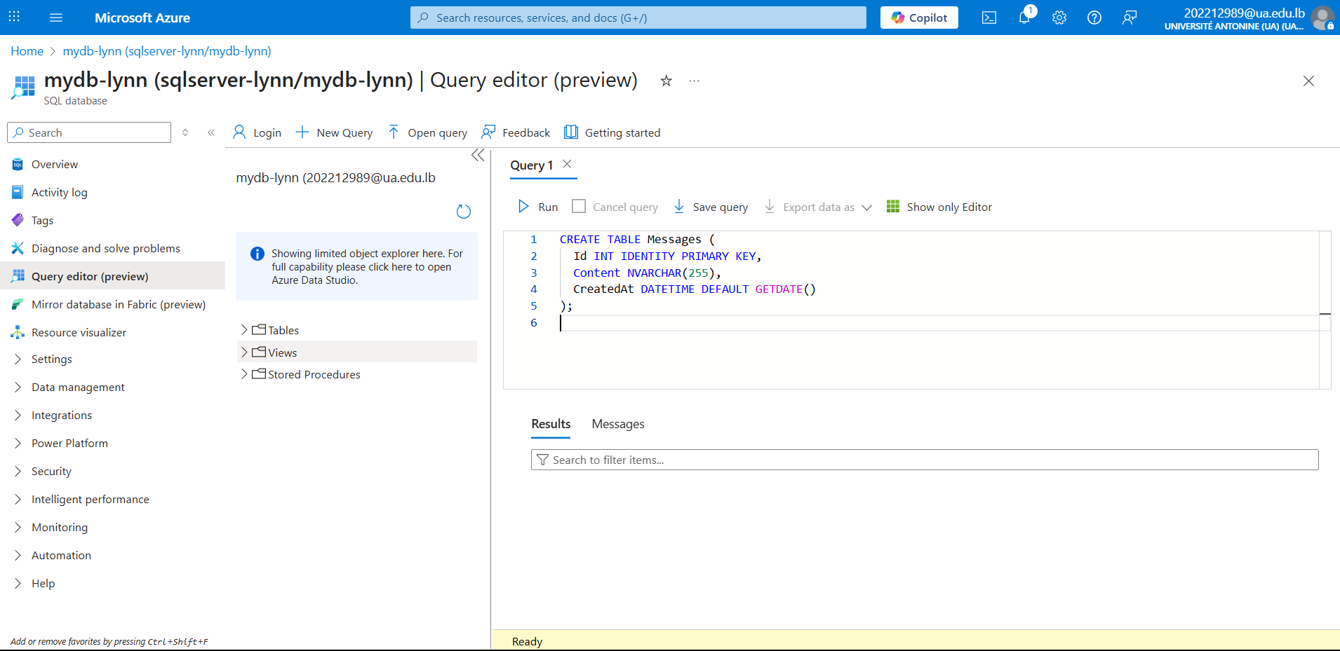
Writing Query

Slide 16
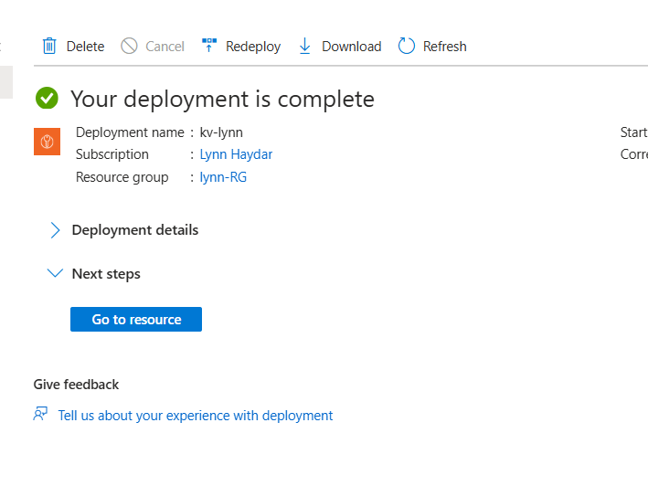
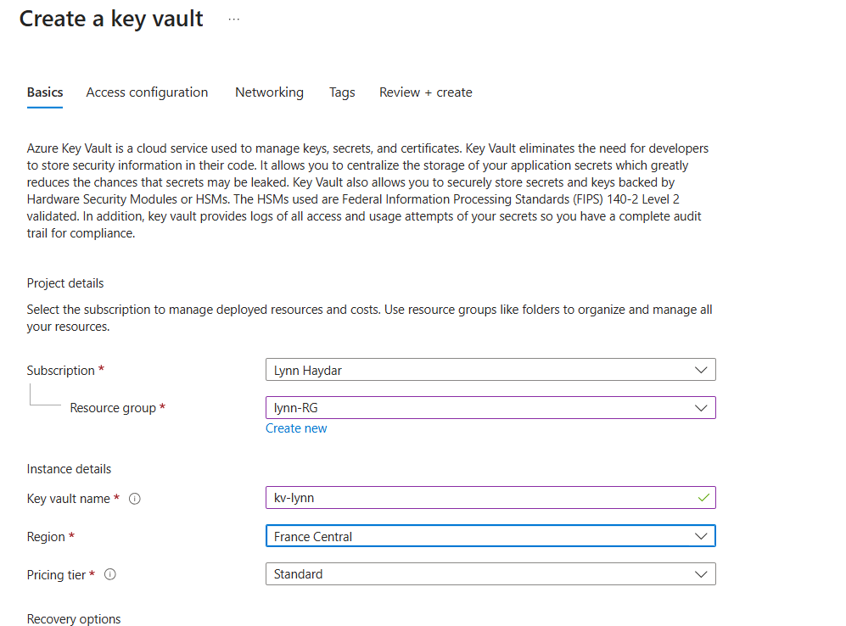
Create the Key Vault + Add Secrets

Slide 17
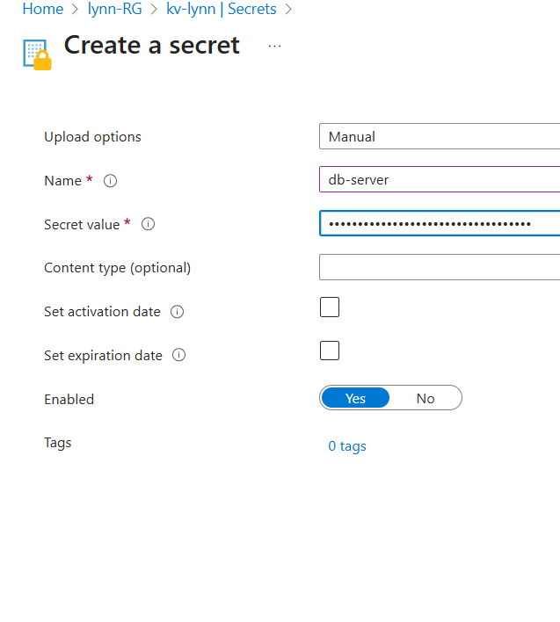
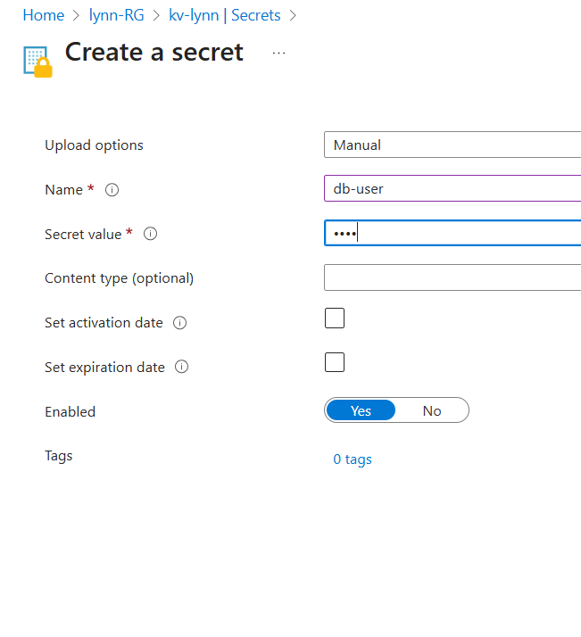
Create the Key Vault + Add Secrets

Slide 18
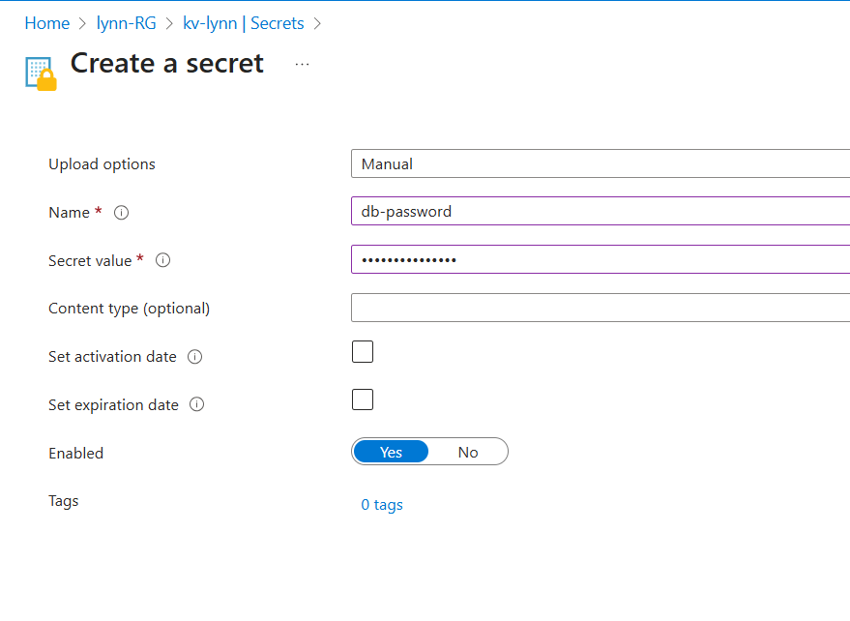
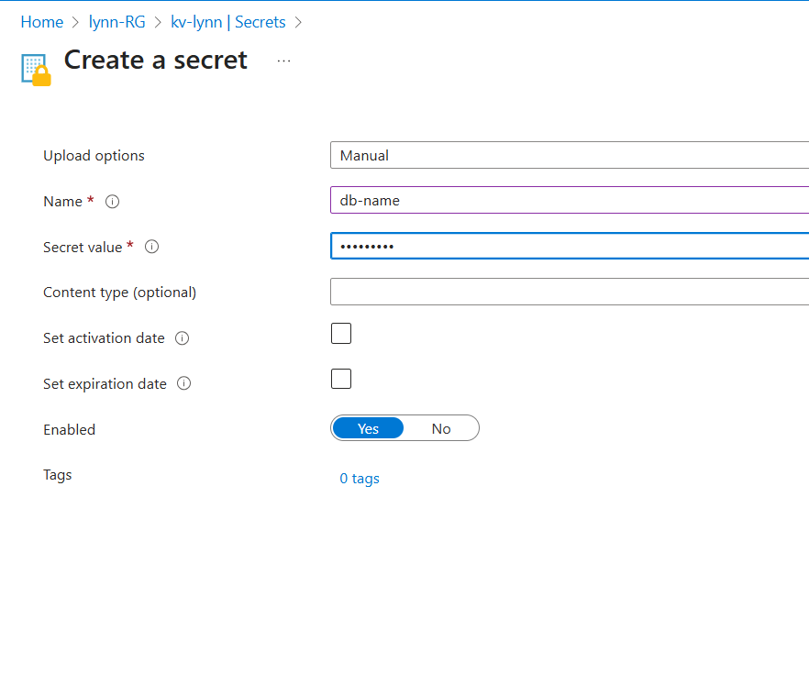
Create the Key Vault + Add Secrets

Slide 19
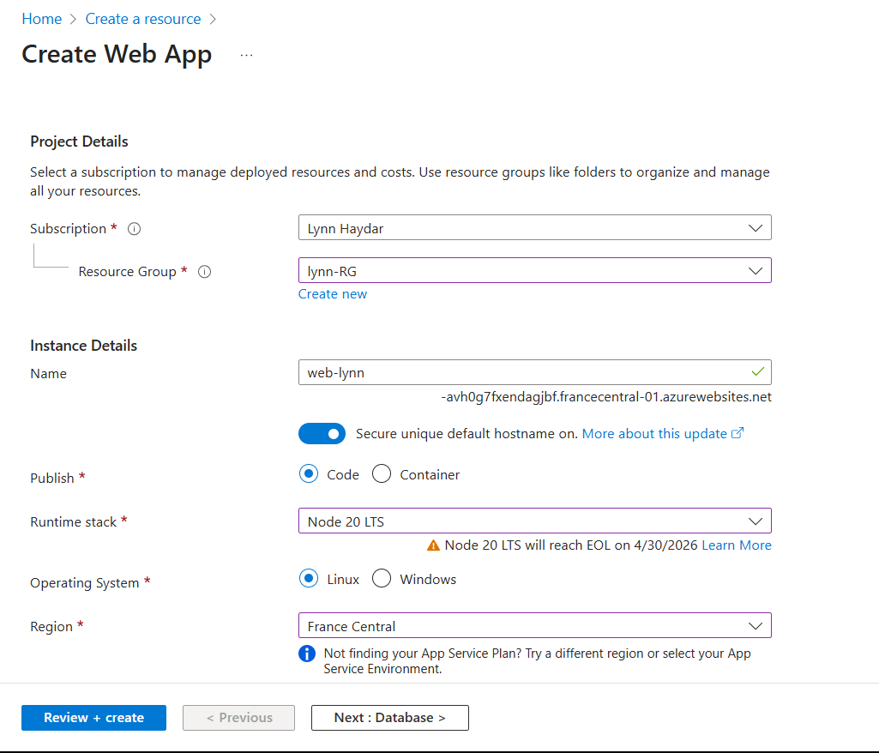
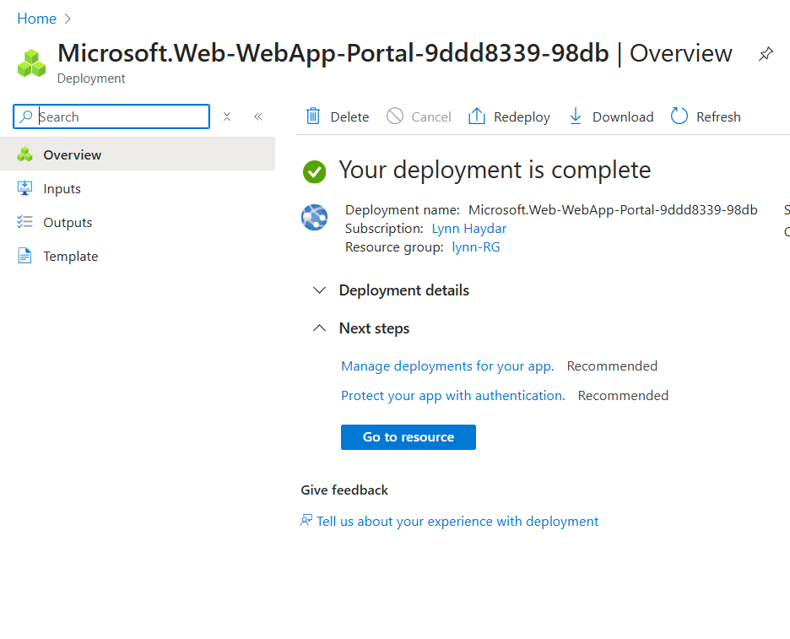
Create the Azure Web App Node.js

Slide 20
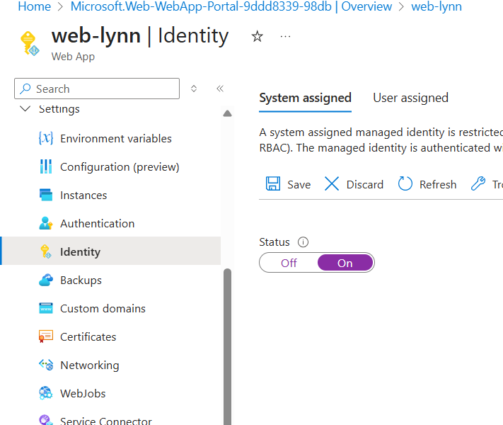
Enabling managed identity
This allows my app to access Key Vault securely.

Slide 21
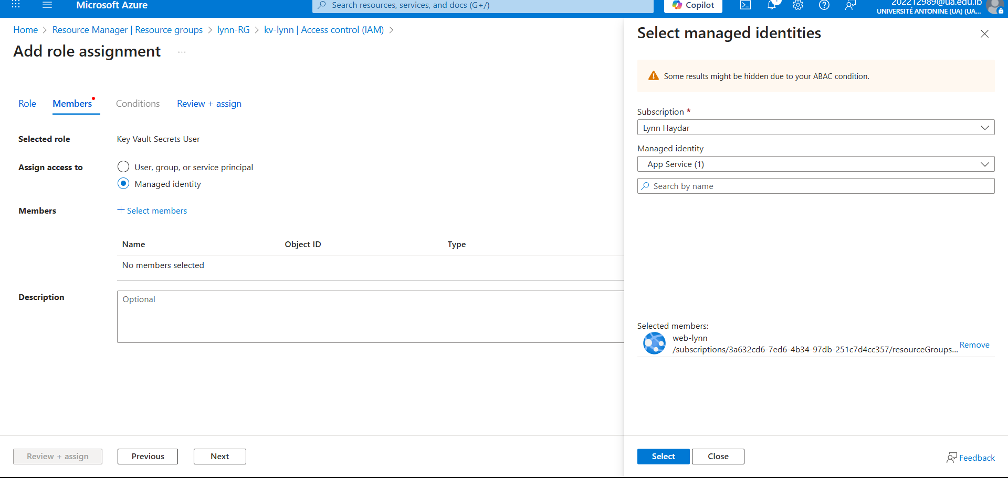
Give Web App Access to Key Vault
Go to my key vault -> IAM -> add role assignment -> choose key vault secrets user -> select web-lynn

Slide 22
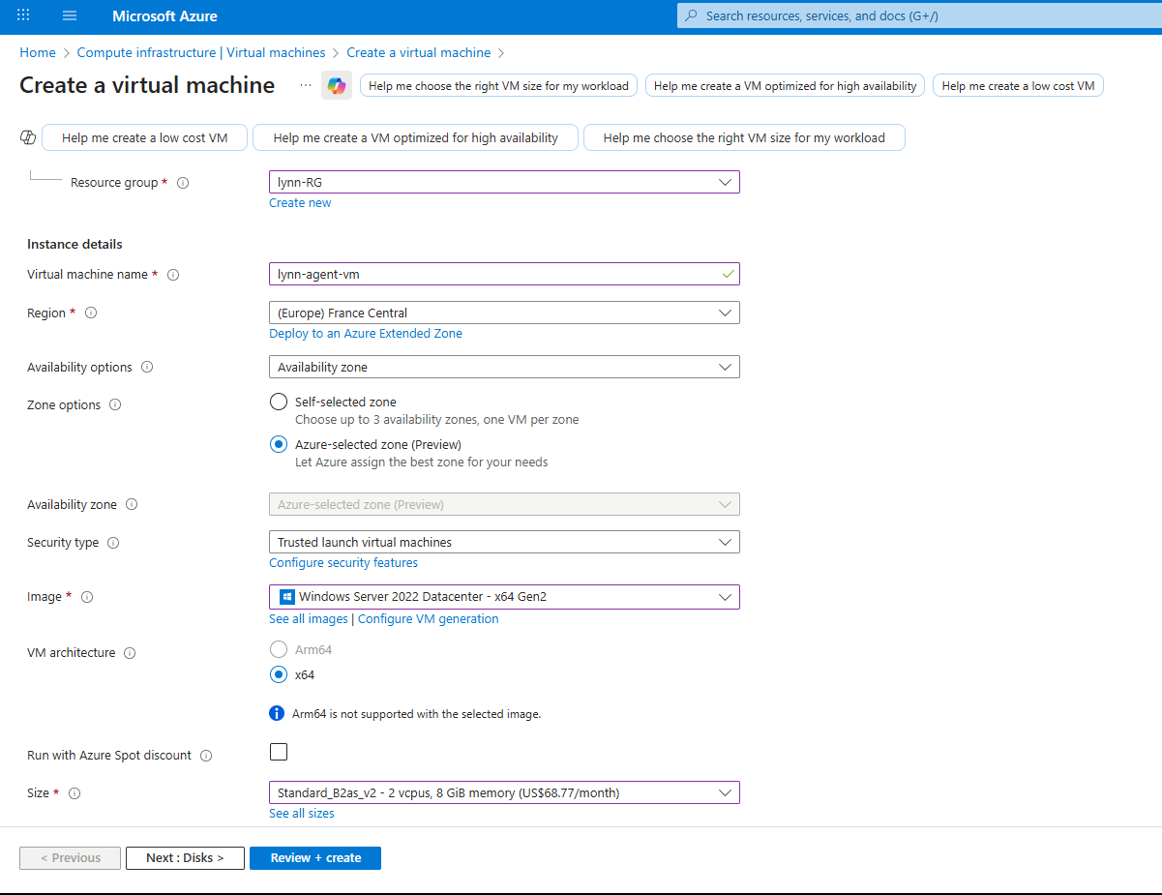
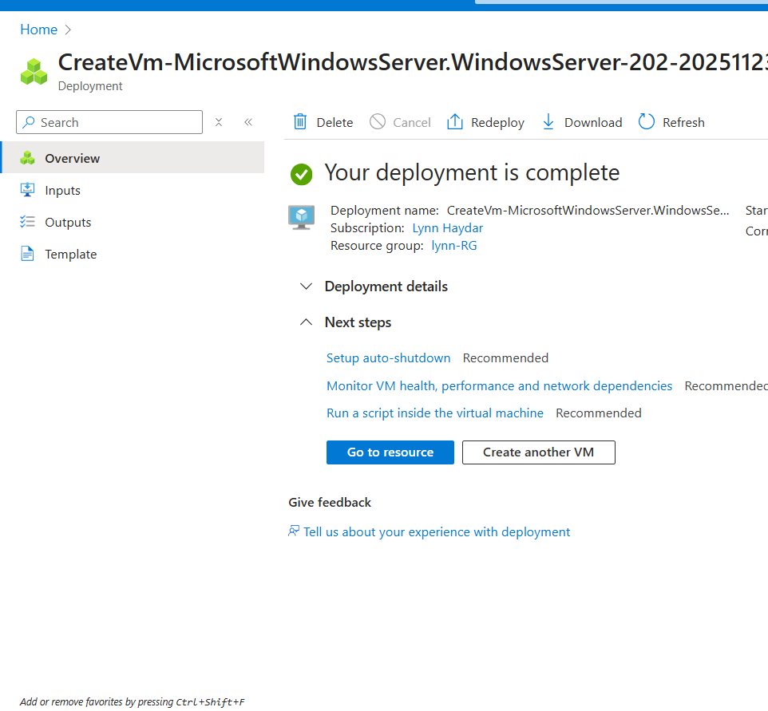
Create Virtual Machine

Slide 23
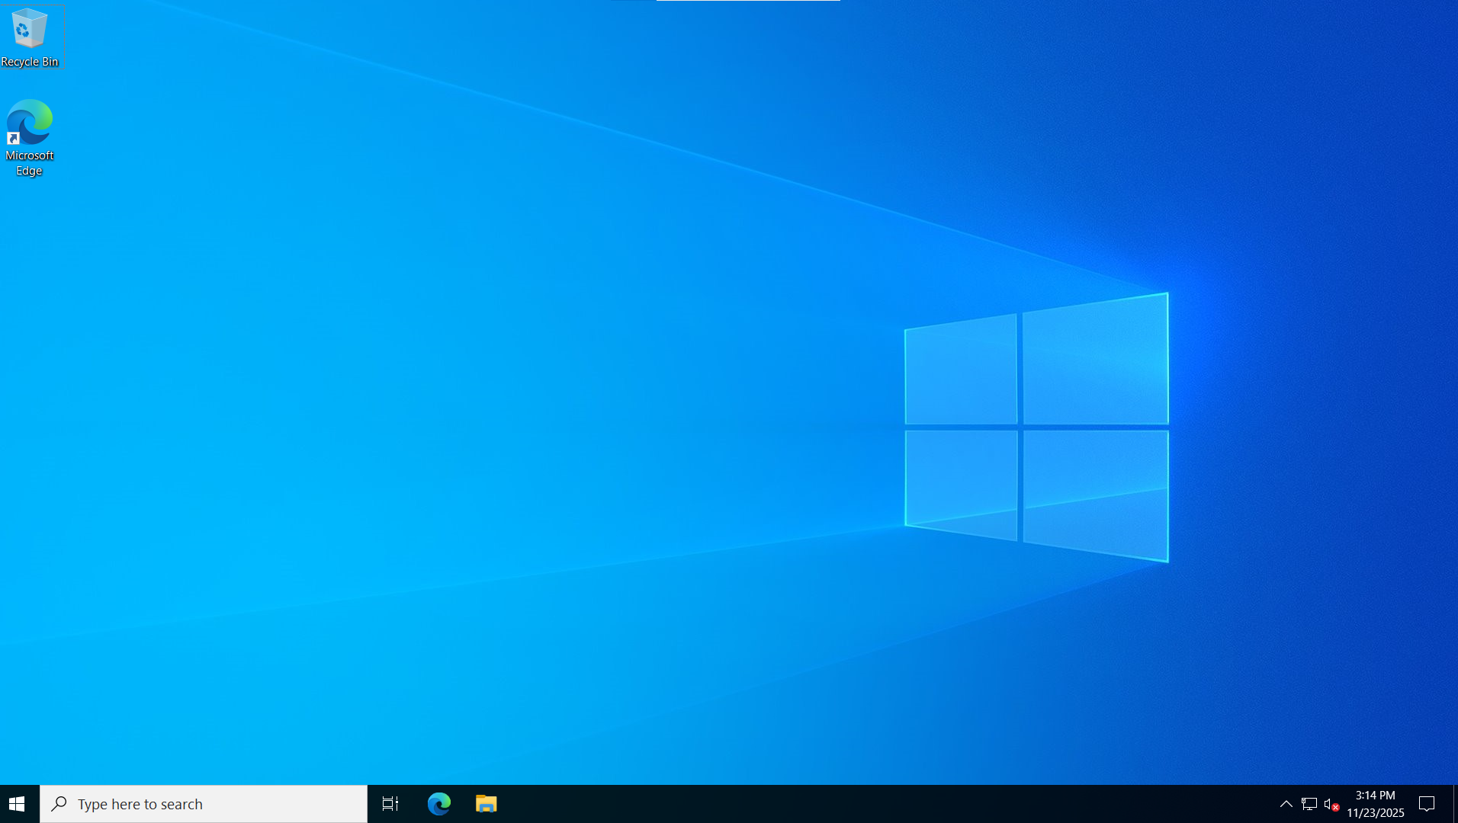
Download RDP and log in

Slide 24
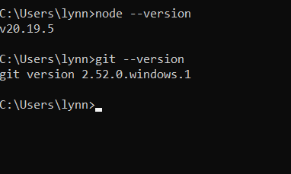
Install requirements inside the VM: Node.js 20 LTS and GIT

Slide 25
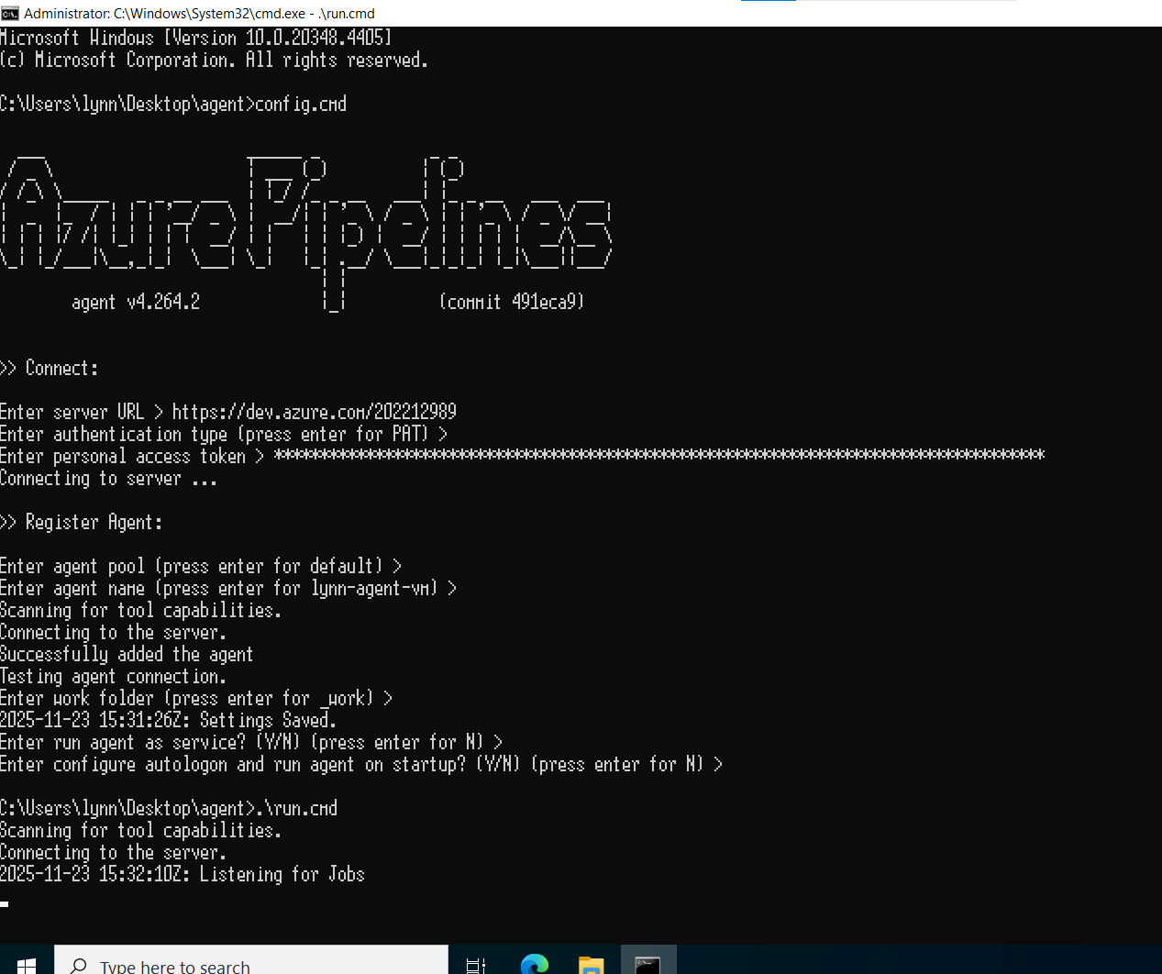
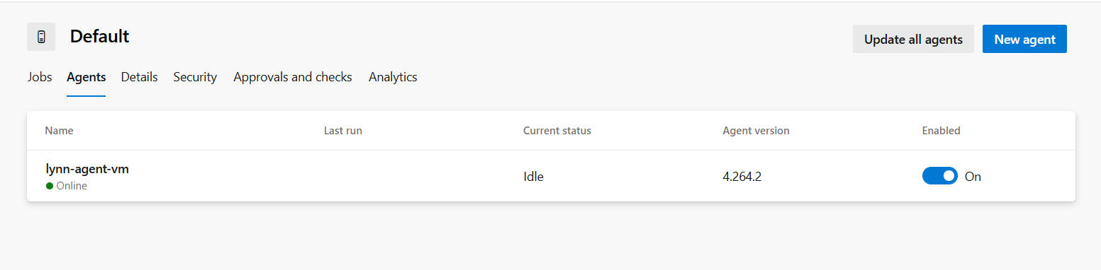
Install agent on VM
Log in to Azure DevOps -> agent pools -> default -> new agent -> download it -> extract -> configure -> run

Slide 26
Azure Repos
03
Clone empty repos and push it locally

Slide 27
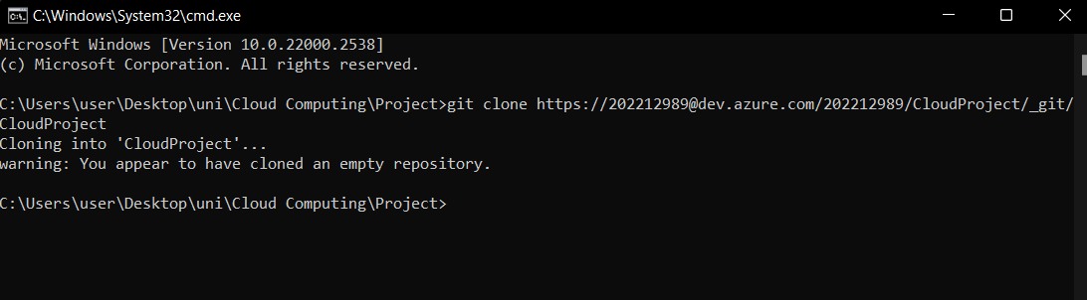
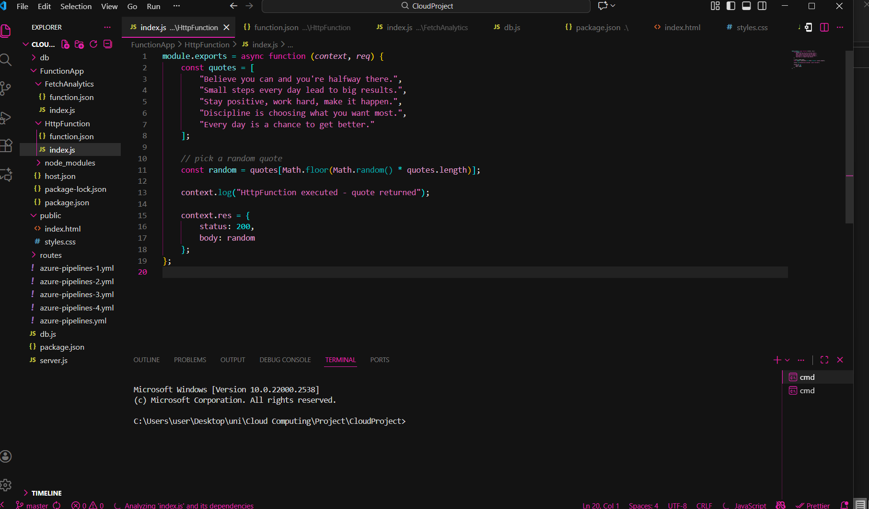
Clone

Slide 28
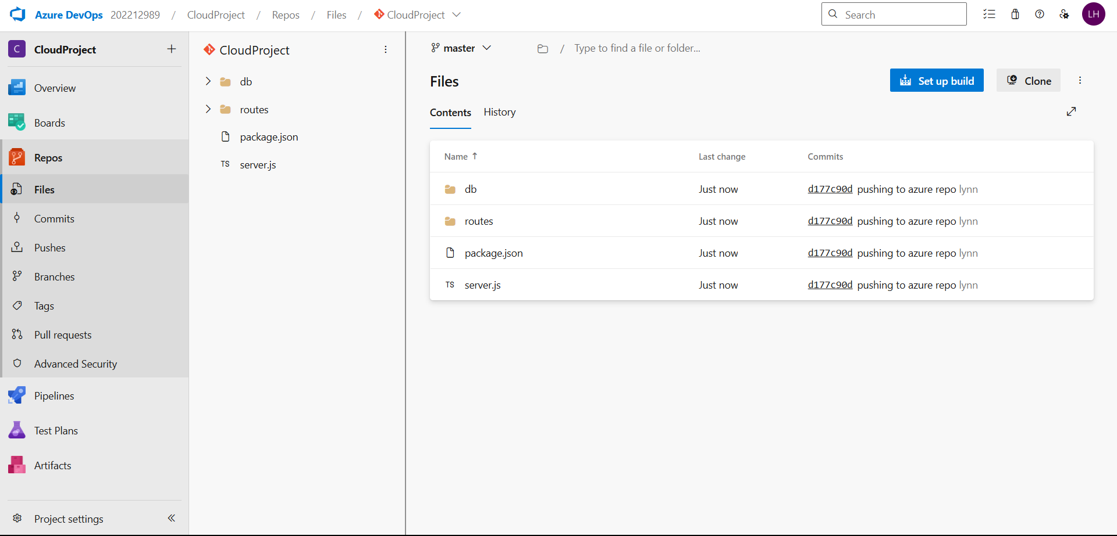
Pushed Successfully

Slide 29
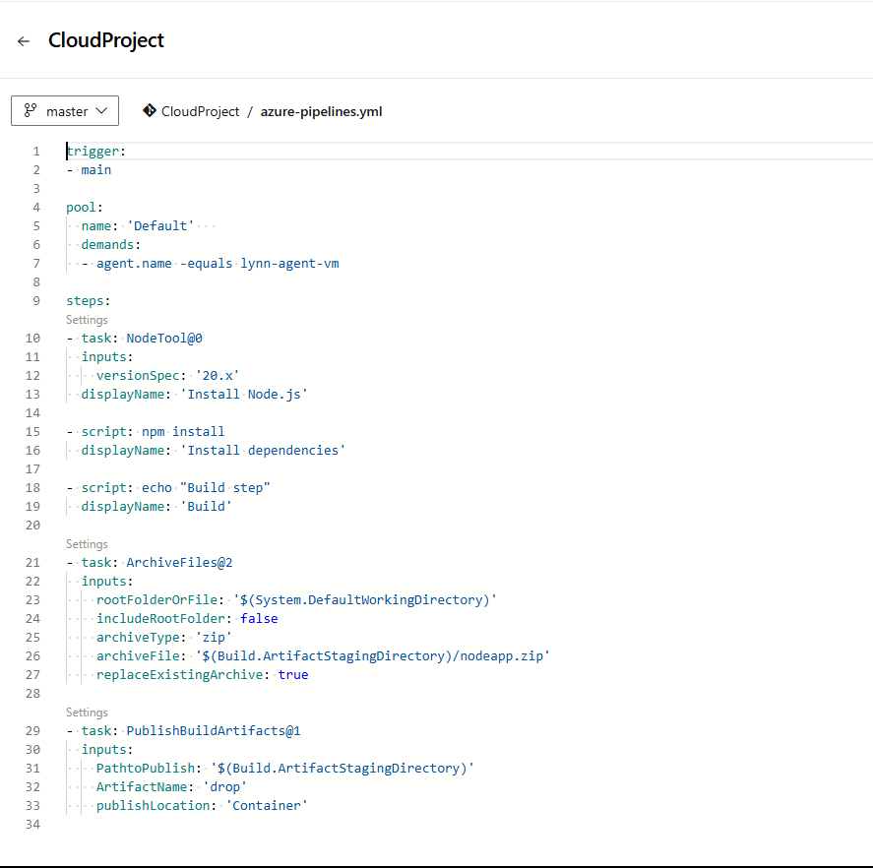
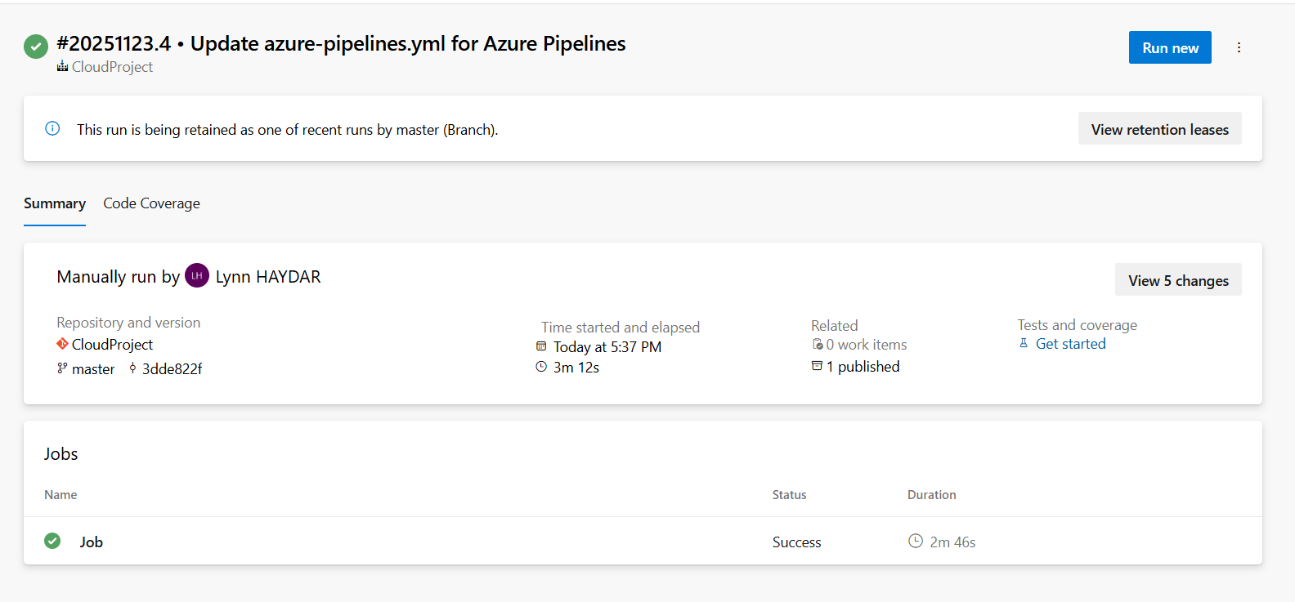
Create the build Pipeline (CI) YAML
this pipeline:
Installs Node.js 20
Installs dependencies (npm install)
Creates a ZIP file containing entire project
Publishes the ZIP as a build artifact (for the Release pipeline)

Slide 30
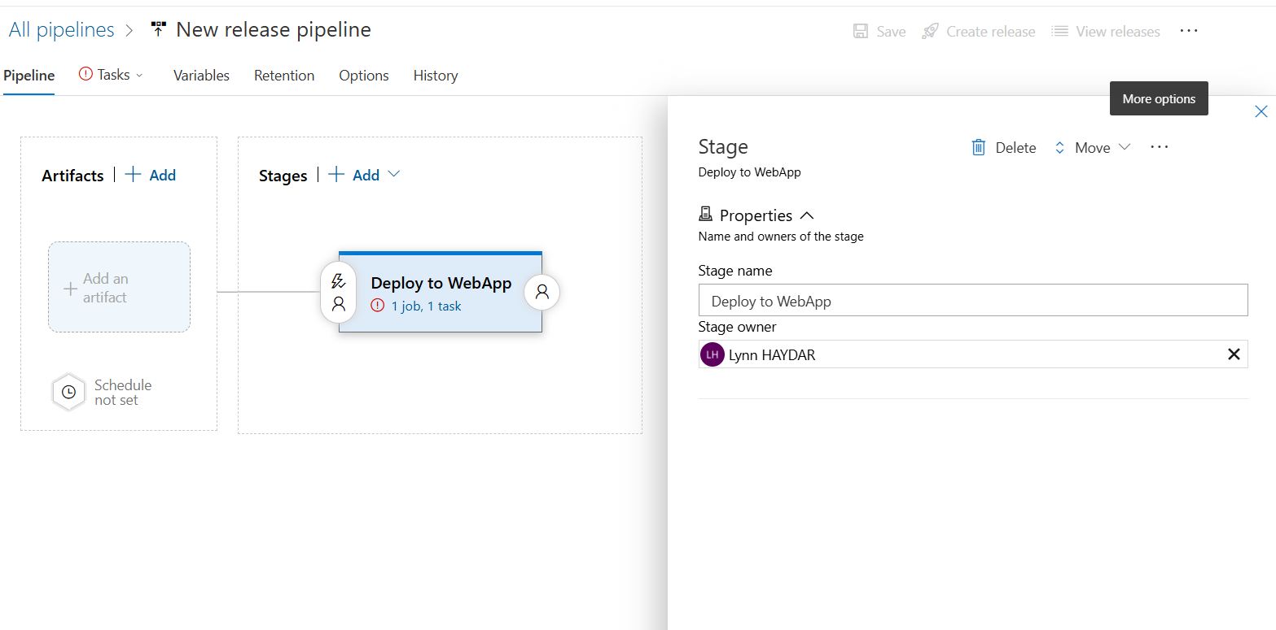
Create the Release Pipeline (CD)

Slide 31
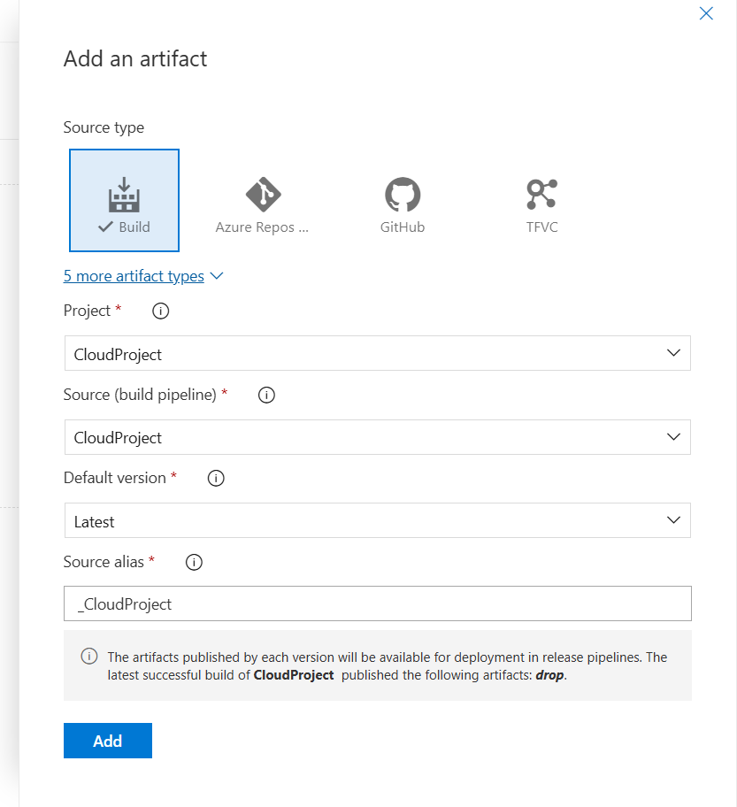
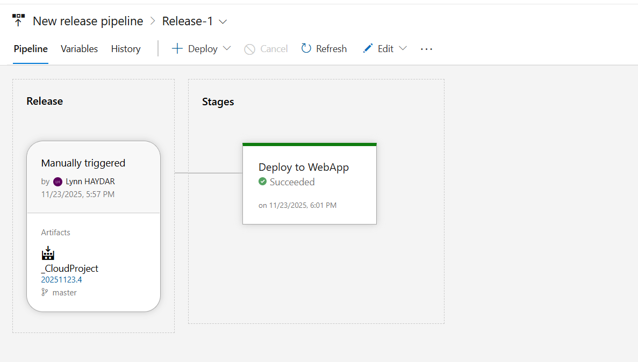
Add an artifact

Slide 32
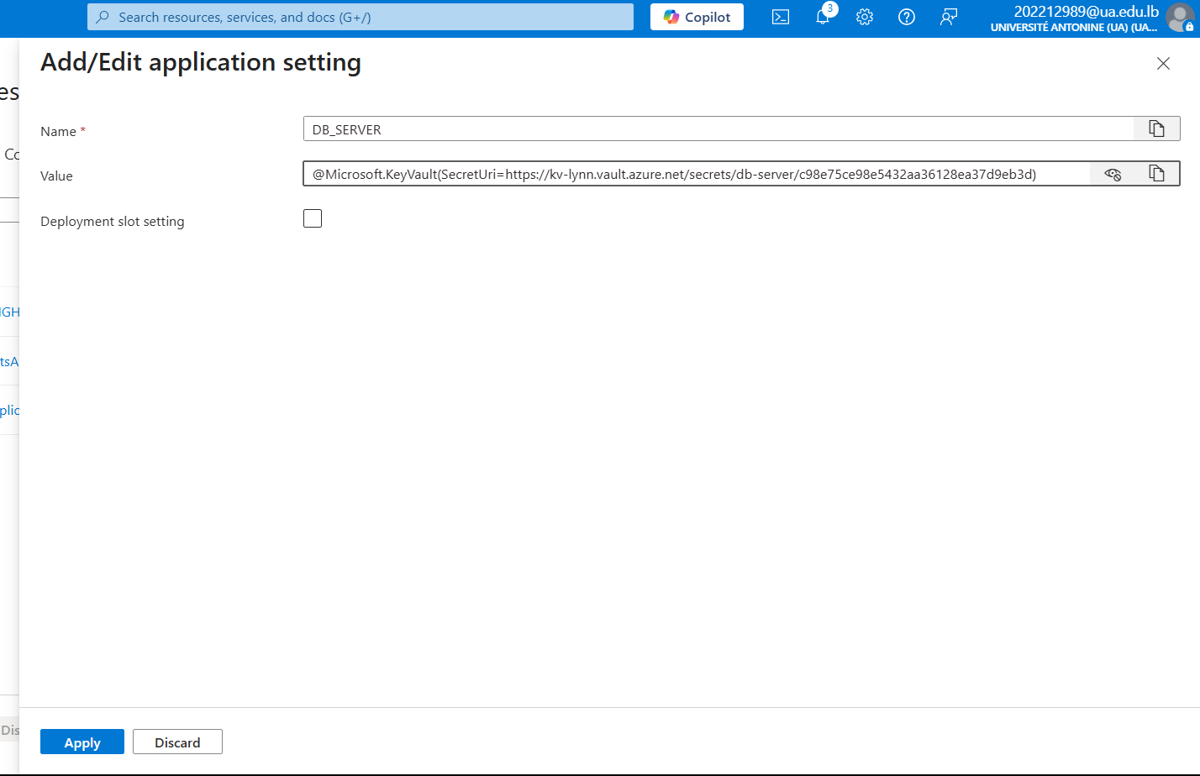
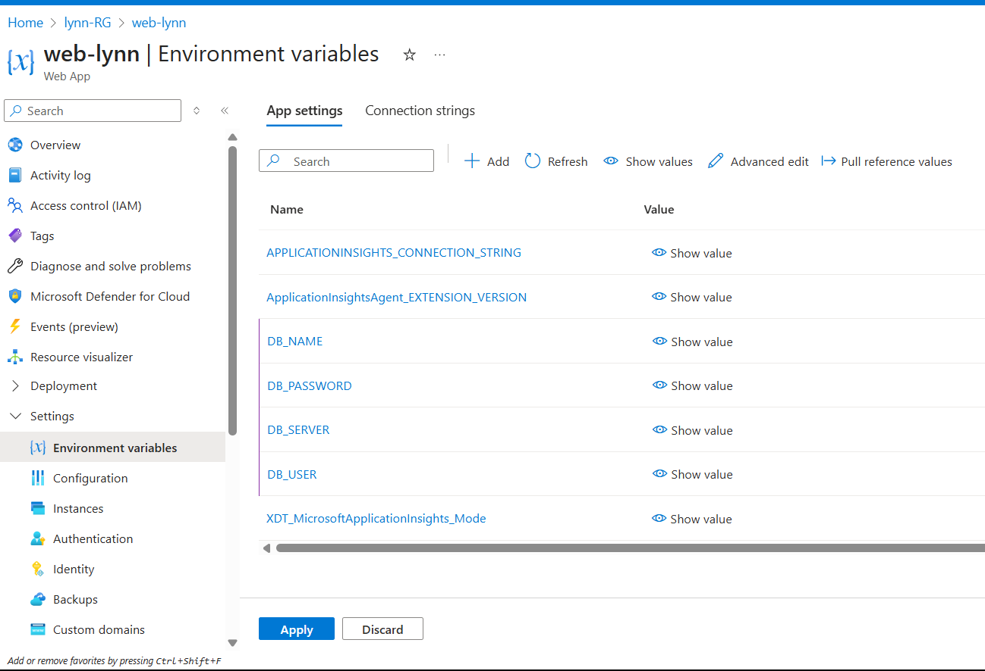
Configure Web App to use Key Vault Secrets
To be able to connect to SQL, Now go to environment variables -> app settings and add the variables, copy the link from key vault kv-lynn.

Slide 33
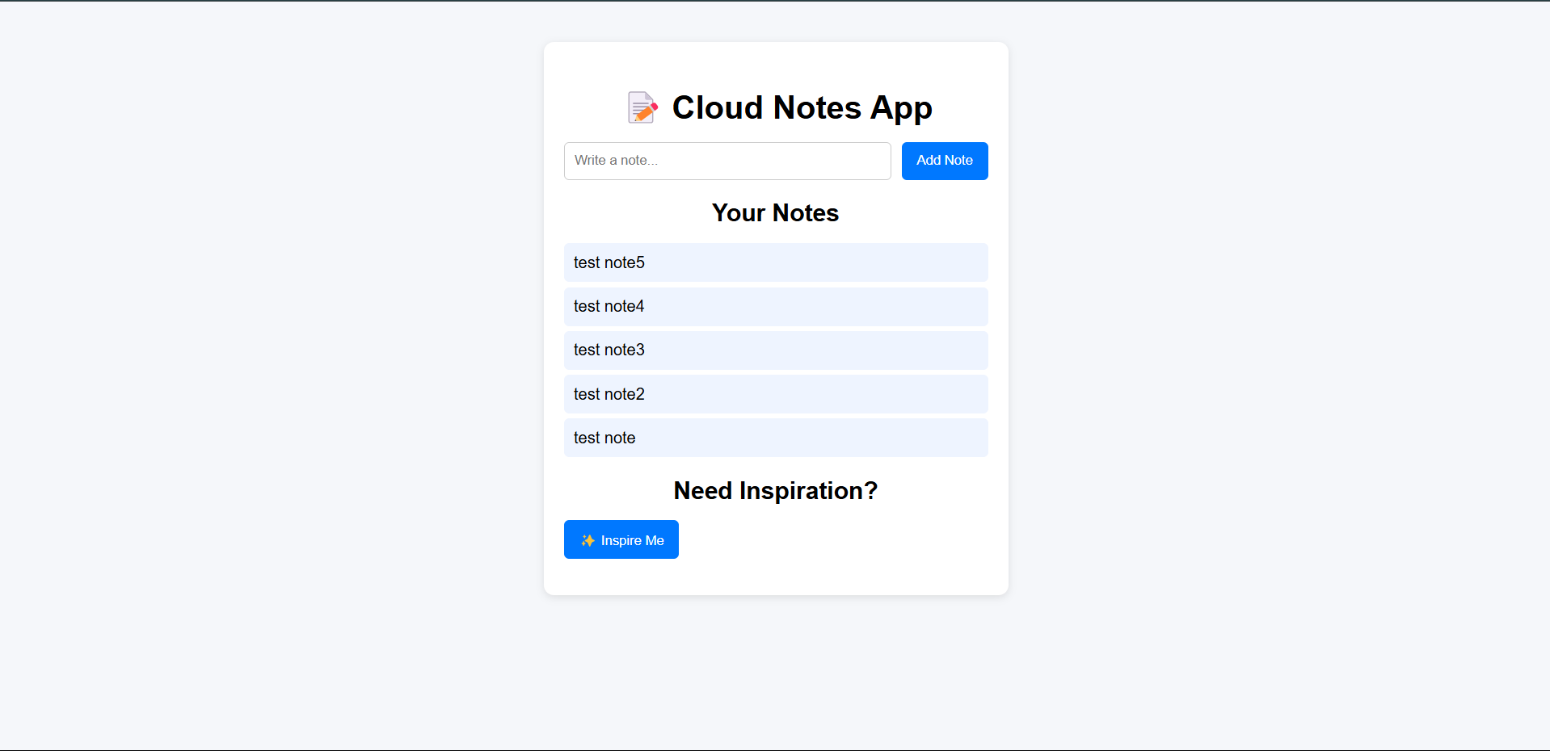
Web Result

Slide 34
Function App
03

Slide 35
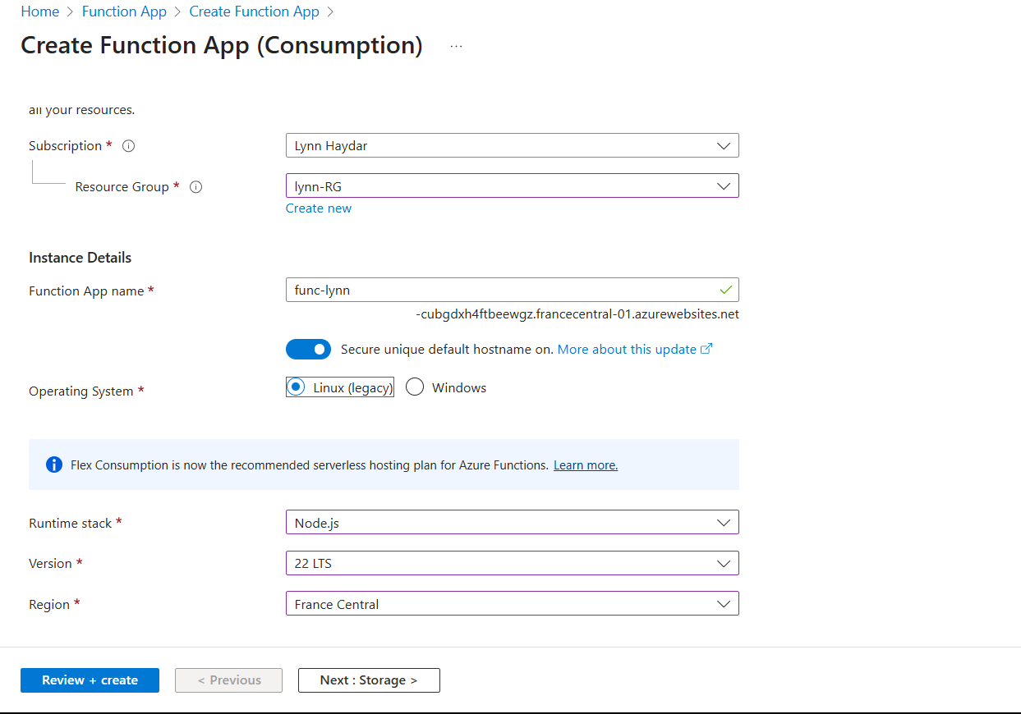
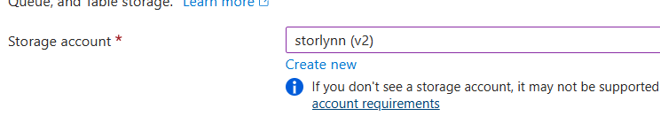

Create Function App Azure Portal

Slide 36

Enable managed identity

Slide 37

Give Function App access Key Vault

Slide 38

Create Functions Locally
HTTP Function

Slide 39

Create Functions Locally
Fetch Analytics Function

Slide 40

Push to Azure Repos

Slide 41


Create the CI pipeline for FunctionApp
This pipeline will:
✔ Install Node.js
✔ Install Azure Functions Core Tools
✔ Install dependencies for your FunctionApp
✔ Package it into a ZIP file
✔ Publish it as an artifact for the Release Pipeline

Slide 42


Function App Result

Slide 43
Thank you
Do you have any questions?

